Slide 1
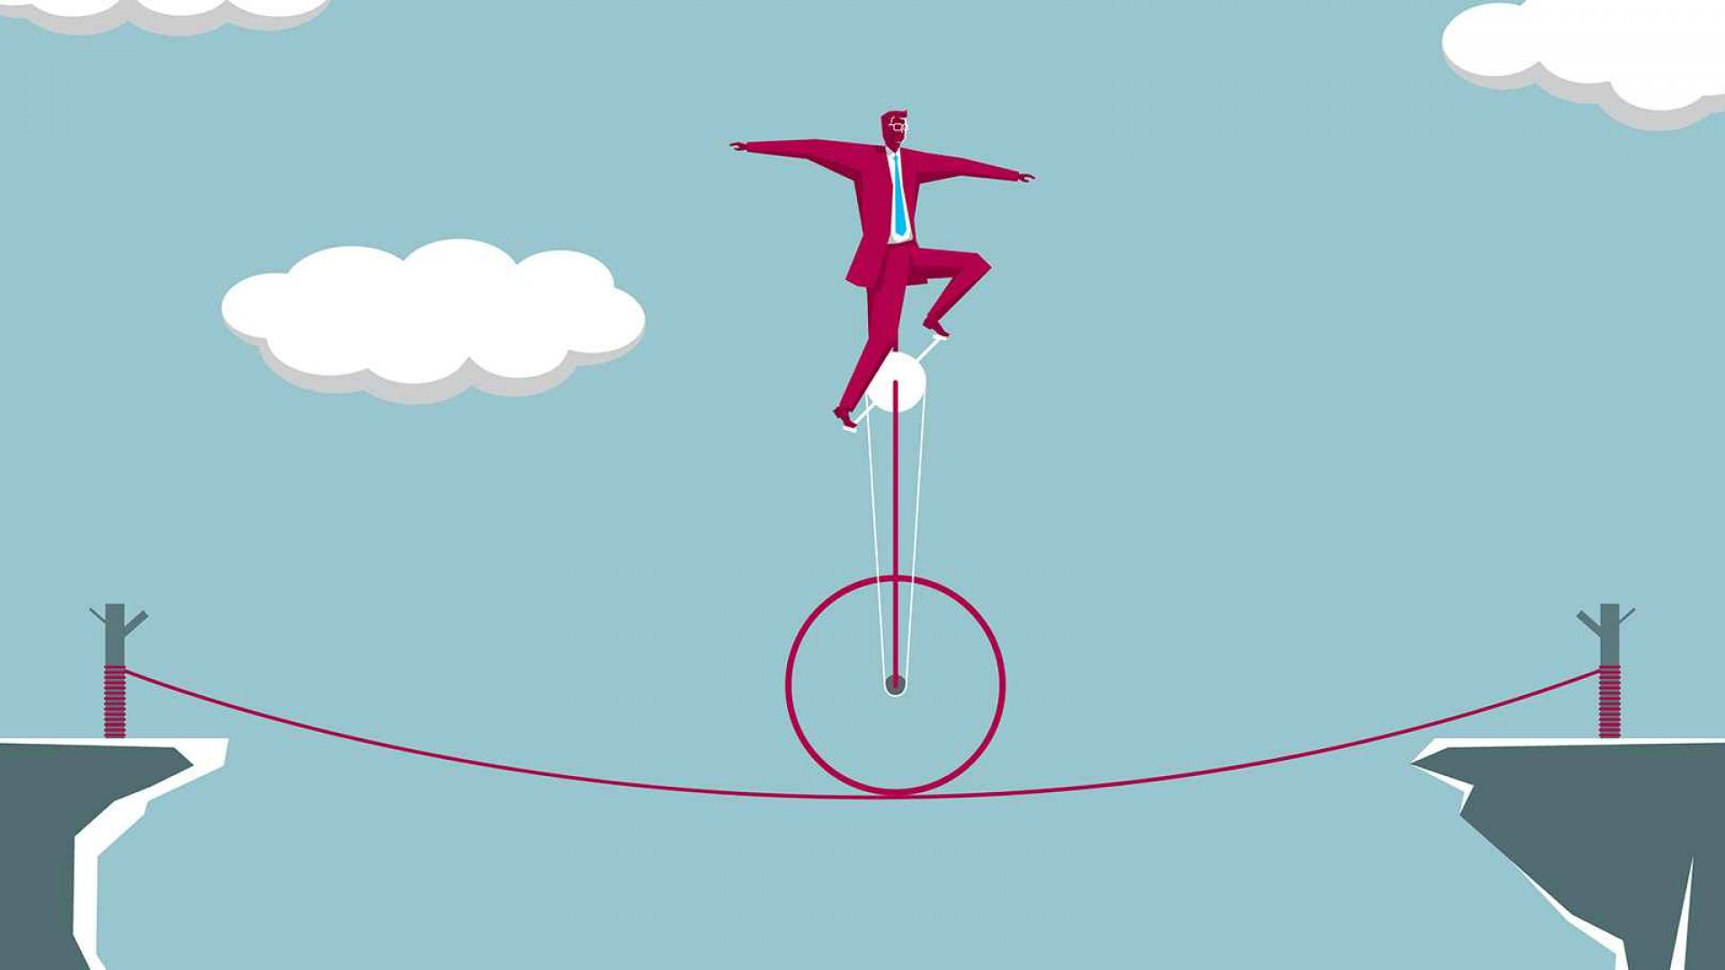

Risks of the Entrepreneur

Slide 2
“YOU CAN NEVER CROSS THE OCEAN UNTIL YOU HAVE THE COURAGE TO LOSE SIGHT OF THE SHORE”

Slide 3
Is risk bad for an Entrepreneur?
The biggest risk is not taking any risk….
(Mark Zuckerberg)
According to statistics, there is a high rate of failed businesses.
90% of businesses fail in the first year.
Taking risk is a skill for successful entrepreneur.

Slide 4
All forms of business have some degree of risk. These risks may bring losses but they may also bring profits and expansion of the business. A focused entrepreneur should consequently be able to analyze all business ideas and plans and identify those that represent a serious risk to their business (in terms of both possible upsides and downsides). All the same, risks cannot be avoided in business.
If a particular risk involves too much time and money, it is wise to avoid it unless there are sufficient contingency resources to deploy. After all, ideas that promise a large profit are often the same ideas that can bring enormous loss to a business.

Slide 5
Causes of losses
There are many risks associated with businesses, some of which can be avoided and others which just become part of an entrepreneur’s day-to-day life. One of the greatest risks in a business is the risk of running at a loss.
bad business decisions
recessionary conditions
other changes in the market.

Slide 6
Entrepreneur means risk.
The risk of walking away from security and career path to create something new
The risk of taking yourself and your family into an unfamiliar storm of stress and uncertainty
The risk that you’ve miscalculated an opportunity
The risk that you’ve miscalculated your own internal resources as you plunge into a new venture.

Slide 7
Types of Risks
Market and opportunity risk
The market does not always remain stable. It fluctuates in many ways and may even be highly seasonal. Many variables cause this. Steady profits may not always be there so planning for a “rainy day” becomes critical.
Competitive risk
Stiff competition can wipe out a business completely. Many times small ventures cannot survive the onslaught of big ventures. The latter have money to advertise and publicize their products. They may also drop prices to very low levels to drive a smaller venture out of business.

Slide 8
Financial risk
An entrepreneur is usually in debt as he or she has to borrow money to invest. Often he or she suffers losses and is unable to pay up the loans.
Operational risk
Products remain unsold in the market as the purchasing power of the individual comes down. Business people cannot sell their products and as a result are unable to make profits.

Slide 9
Other types of Risks
No steady paycheck
Sacrifising personal capital
Relying on cash flow
Interest in your product/ services
Poor recruitment
Trusting employees
Betting on a crucial deadline
Committing personal time and health
Emotional risk

Slide 10
Risk is the main cause of uncertainty in any organisation. ... The ability to manage risk will help companies act more confidently on future business decisions. Their knowledge of the risks they are facing will give them various options on how to deal with potential problems.

Slide 11
Importance of Good Risk
It helps to reduce uncertainty
It is crucial for successful planning
It helps reduce expenses and losses
It helps improve your reputation

